Slide 1
Final Report
Predicting Home Loans approval with Machine Learning

Slide 2
Agenda
Data Science Lifecycle​
Project Overview​
Data
Analysis
Modeling
Model Evaluation

Slide 3
Data Science Lifecycle
Basic understanding of the business problem
Receiving data from the stakeholder
Data Cleaning
Exploratory data analysis
Feature selection
Implement Machine learning algorithms
Evaluating the results.
Repeat steps 5 to 7 again for better results.

Slide 4
Project Overview
This project aims at predicting the loan approval status for the customers by using the traditional machine learning algorithms.
This study also aims at understanding the features which has more impact on the loan status.
Models like Logistic regression, Decision tree and random forest has been used in this project.

Slide 5
DATA Overview
We have total 13 features in our data set.
The number of records we have is 614 including null values.
Data types : float64(4), int64(1), object(8)
We have no duplicate values in our data set.

Slide 6
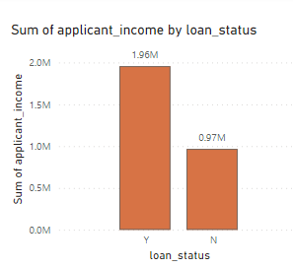
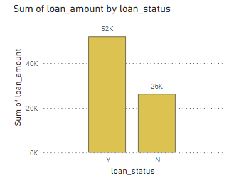
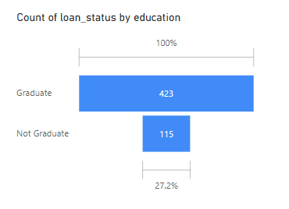
Analysis

Slide 7
ANALYSIS COND.
From the graphs in the previous slides, we can see that the loans have been approved for higher income customer.
We can also see that the higher the loan amount, higher the approval rate.
From the funnel chart, we can say that the customers who are graduates have high loan approval rates.

Slide 8
Modelling
Logistic Regression - Logistic regression is use for classification problems where we have to predict the binary classes like ‘yes’ or ‘no’, ‘0’ or ‘1’. It uses sigmoid function to give us a ‘S’ shaped line. In this project we have to predict whether the customer has churned or not churned which encoded as ‘no’:’0’, ‘yes’:’1’.
Decision Tree - Decision trees are a type of algorithm used in machine learning. Unlike some other methods, they don't rely on strict rules about how data should look. Instead, they can adapt to different shapes and patterns in the data they're given.

Slide 9
Model Evaluation
Confusion matrix – Confusion matrix is evaluation tool for classification problems in machine learning. There are four quadrants in confusion matrix – True Positives, True Negatives, False Positives and False Negatives. Confusion matrix also helps us to calculate the accuracy of the model.
Logistic regression accuracy = 77%
Decision Tree accuracy = 71%
Random forest accuracy = 80%
The Random forest model which is based on decision tree has given us the best accuracy score.

